Slide 1
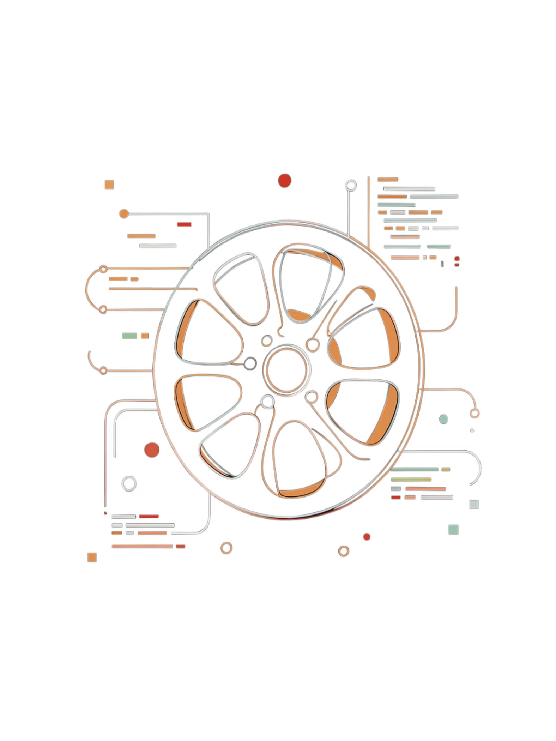
Movie Genre Classification and Recommendation Pipeline
Big Data Pipeline — Hadoop HDFS · Apache Mahout · Docker · CineVault
Sunil Kerketta | Vikas Singh Rajput | Tejendra Kanwar
DSAI Branch, IIIT Naya Raipur, Chhattisgarh — Semester 2 Big Data Project
Notes:
"Good [morning sir. My name is Tejendra Kanwar and today I'll be presenting our Semester 2 Big Data project titled — **Movie Genre Classification and Recommendation Pipeline.This project was built by our team — Sunil Kerketta, Vikas Singh Rajput . In this project, we have built a complete system that automatically classifies movies into genres and recommends them to users — using big data tools like Hadoop, Apache Mahout, and Docker."

Slide 2
Agenda
01
02
03
Problem Statement & Motivation
System Architecture — 4 Layers
Data Ingestion Layer (TMDB API)
04
05
06
Dataset Overview & Genre Distribution
Distributed Storage — Docker + HDFS
AI Engine — Mahout MapReduce Pipeline
07
08
09
TF-IDF Vectorisation Deep Dive
Complementary Naive Bayes Classifier
Pipeline Execution Workflow (Commands)
10
11
12
CineVault Dashboard Demo
Results & Key Achievements
Conclusion & Future Work
Notes:
"Before I begin, let me quickly walk you through what we'll be covering today.
We'll start with the **problem we are solving* and why it matters. Then we'll explain our *system architecture* — which has 4 layers.
After that, we'll go into each layer one by one — starting from *how we collected the data, then **how we stored it, then **how our AI model works,
and finally we'll show our **CineVault dashboard, which is the frontend of our system.

Slide 3
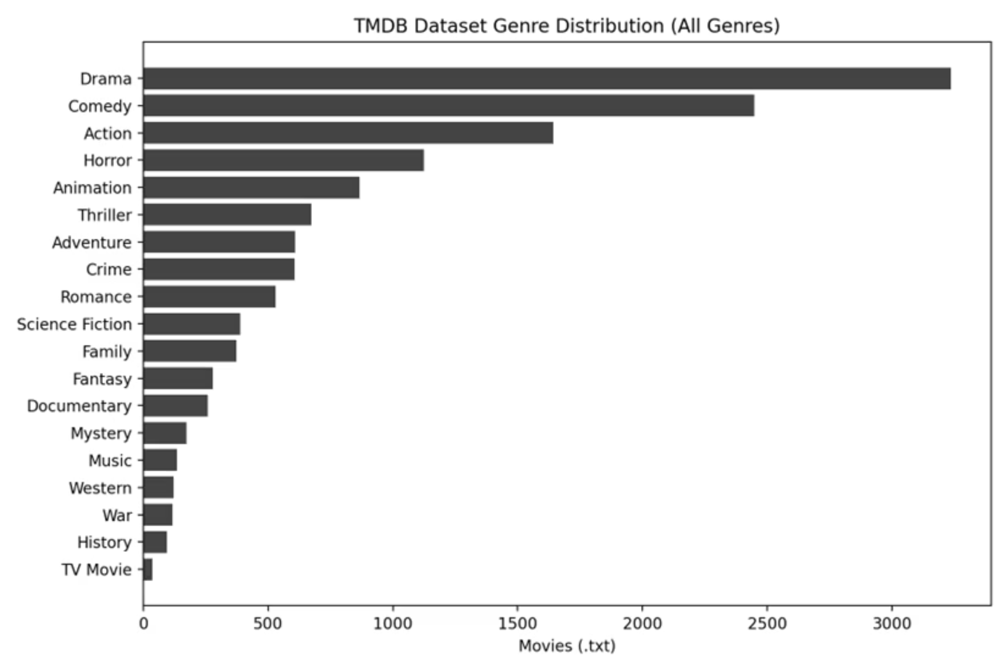
Problem Statement & Motivation
The Problem
Streaming platforms host millions of titles — manual genre tagging is infeasible at scale
Traditional single-node NLP pipelines cannot handle millions of movie descriptions
Class imbalance: Drama (3,235), Comedy (2,449), Action (1,642) vs. War (117), Western (122)
Motivation & Solution
Accurate genre prediction directly improves recommendation quality and user retention
Solution: Distributed Big Data pipeline with Docker + Hadoop + Apache Mahout + TF-IDF + CNB
Notes:
"So, what problem are we solving?Think about platforms like Netflix or Amazon Prime — they have **millions of movies. Someone has to assign the correct genre — like Action, Drama, or Comedy — to every single movie. Doing this **manually is simply not possible* at that scale.*
On top of that, traditional systems that run on a **single computer* cannot handle millions of movie descriptions at once. They run out of memory and become too slow.*
There's also another challenge — the data is **imbalanced. For example, we have 3,235 Drama movies but only 117 War movies. This makes it harder to train a fair AI model.
Our motivation is simple — if we can accurately predict a movie's genre, we can **improve recommendations* for users, which means they stay on the platform longer.*Our solution is a **distributed big data pipeline* using Docker, Hadoop, Apache Mahout, TF-IDF, and a special algorithm called Complementary Naive Bayes — which we'll explain shortly."*

Slide 4
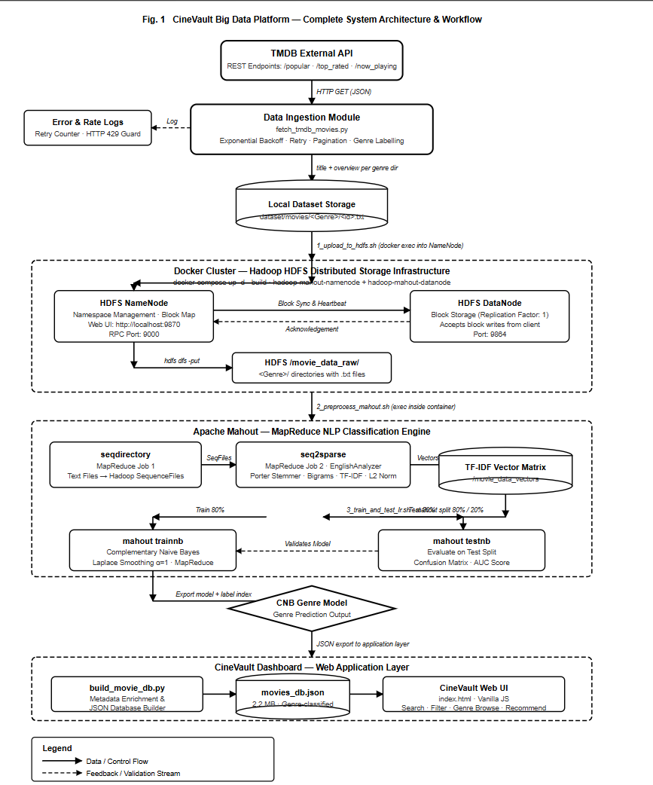
System Architecture Overview

Slide 5





System Architecture — 4 Cooperating Layers
Layer 1 — Data Ingestion
Layer 2 — Distributed Storage
TMDB API → fetch_tmdb_movies.py + enrich_dataset.py
Docker Compose → NameNode + DataNode (HDFS)
Layer 3 — AI Engine
Layer 4 — Dashboard
seqdirectory → seq2sparse (TF-IDF) → trainnb (CNB)
CineVault Web UI (movie_recommender/index.html)
All layers containerised for full reproducibility — one docker-compose up command
Notes:
"Now let me explain how our system is designed. We have **4 layers, each doing a specific job.The
**first layer is Data Ingestion* — this is where we fetch movie data from the internet using the TMDB API, through two Python scripts.
*The **second layer is Distributed Storage* — we use Docker to set up a Hadoop HDFS cluster, which stores our data across multiple nodes so it doesn't overload any single machine.
*The **third layer is the AI Engine* — this is the brain of our system. It converts the movie text into numbers using TF-IDF, and then trains our classification model using Complementary Naive Bayes.
*The **fourth layer is the Dashboard* — this is our CineVault web interface, where users can browse movies and get personalized recommendations.
*One important highlight — the **entire system runs with a single command: docker-compose up. Everything is containerized, so it works the same on any machine."---

Slide 6
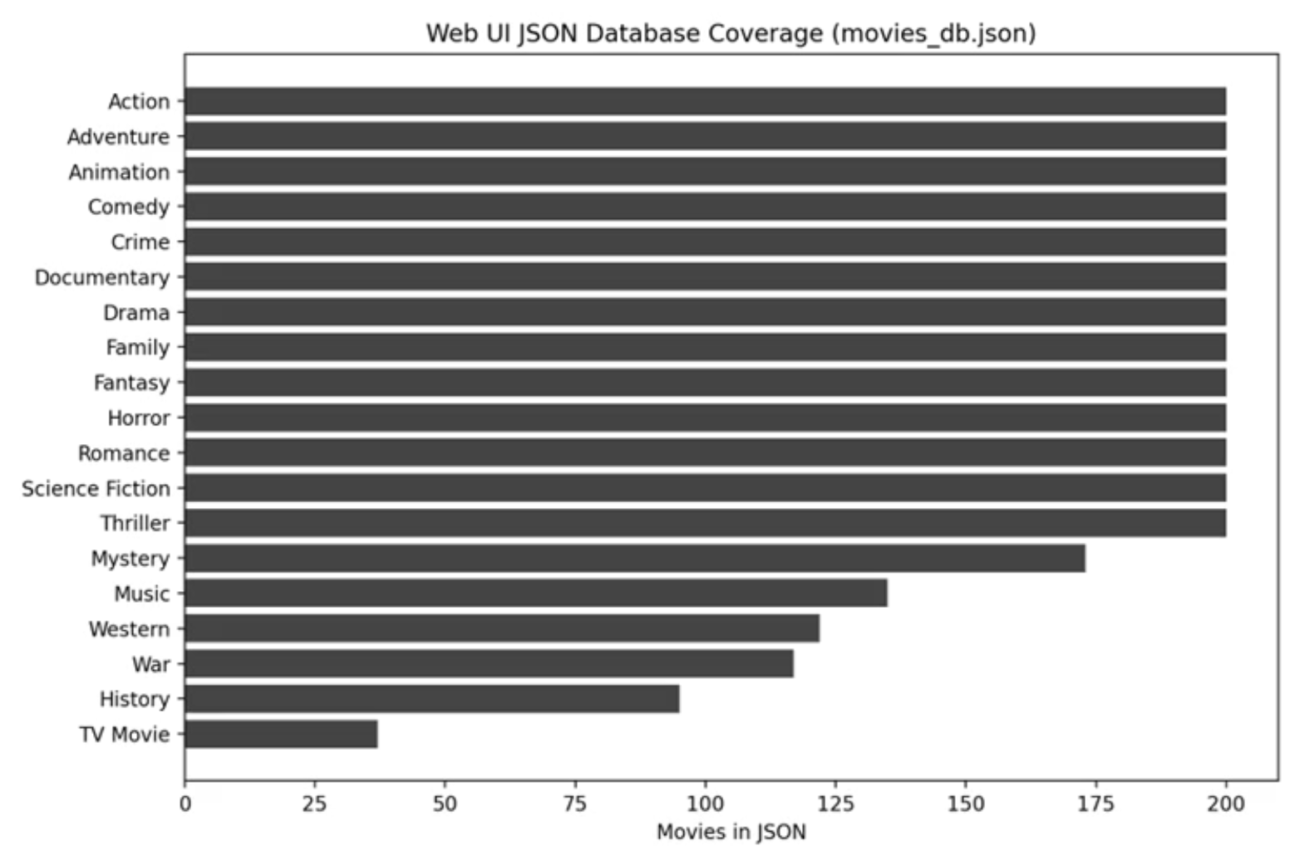
Data Ingestion Layer
Script 1: fetch_tmdb_movies.py
Endpoints: /movie/popular, /movie/top_rated, /movie/now_playing, /movie/upcoming
Max pages: 500 (popular/top_rated), 50 (now_playing/upcoming)
Exponential backoff retry for HTTP 429 Rate Limit responses
Output: dataset/movies/<genre>/<id>.txt (title + overview)
Script 2: enrich_dataset.py
Appends: tagline, keywords (×3 weight), top-3 cast, director
API: /movie/{id}?append_to_response=keywords,credits
Total: ~13,711 movies across 17 genres (≥ 100 movies kept)
Note: VPN may be required if ISP throttles TMDB connection
Notes:
"Let's go deeper into the first layer — Data Ingestion.We wrote two Python scripts to collect our data.
The **first script, fetch_tmdb_movies.py, connects to the TMDB API — which is a popular public movie database. It fetches movies from four categories: popular, top rated, now playing, and upcoming. It can fetch up to 500 pages of popular movies. If the API is overloaded and rejects our request, the script automatically waits and retries — this is called **exponential backoff. Each movie's title and description is saved as a text file, organized by genre.
The **second script, enrich_dataset.py, adds more information to each movie — like the tagline, important keywords, top 3 cast members, and the director. Keywords are given 3 times more weight because they directly describe the movie's genre.After running both scripts, we collected a total of **13,711 movies across 17 genres.

Slide 7
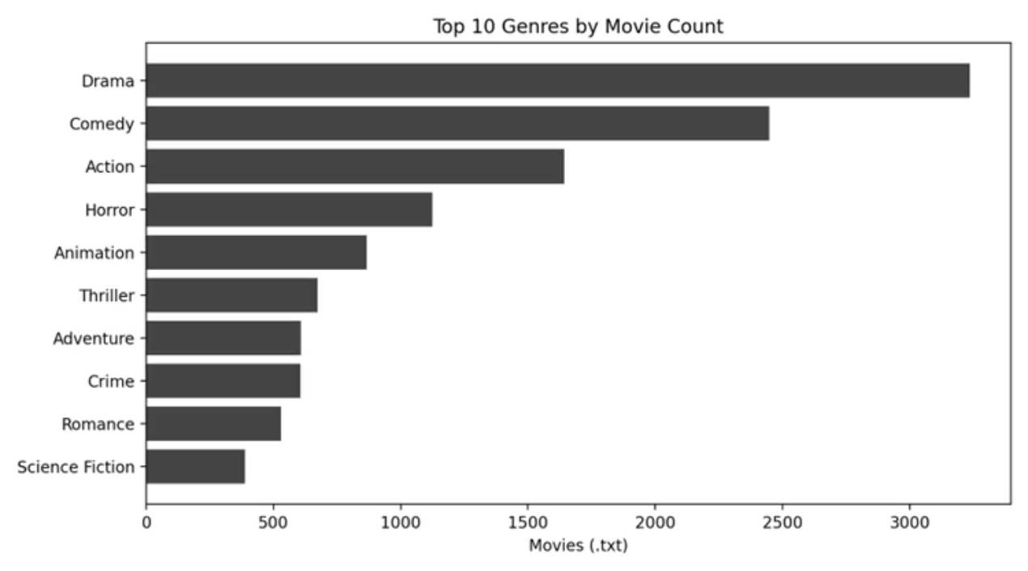
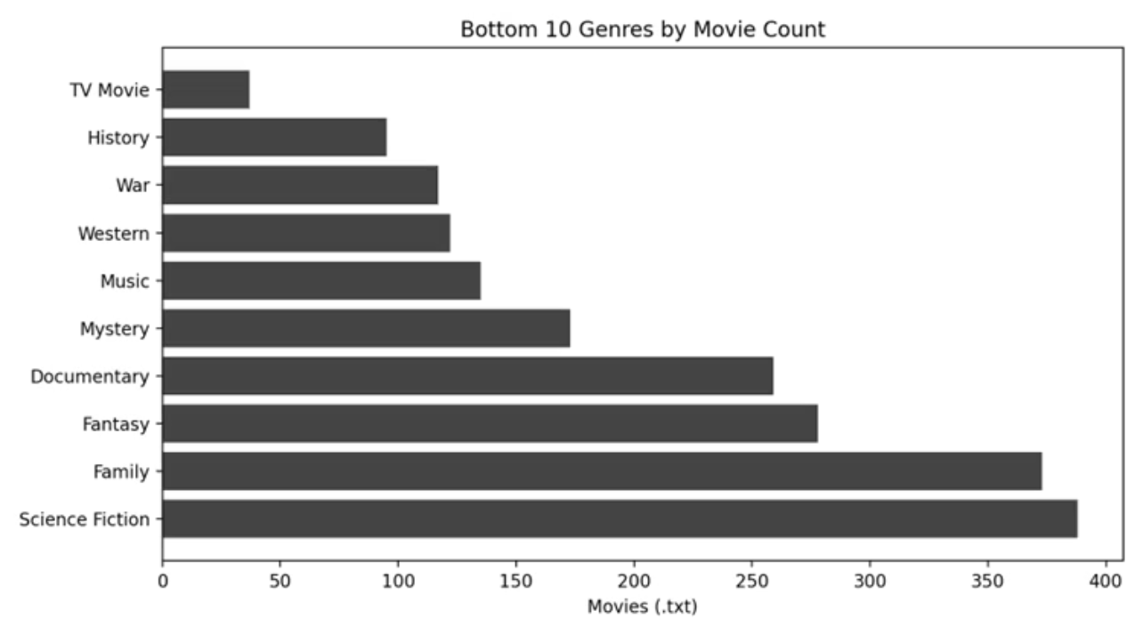
Dataset Overview & Genre Distribution
Total: ~13,711 movies across 19 raw genres. Kept 17 genres (all with ≥ 100 movies) — excluded History (95) and TV Movie (37). Filtered via 0_prepare_filtered_hdfs.sh.
Top Genres
Bottom Genres
Drama 3,235 · Comedy 2,449 · Action 1,642 · Horror 1,125 · Animation 866
War 117 · Western 122 · Music 135 · Mystery 173 · Documentary 259
Notes:
"Now let's look at the data we collected.In total, we have **13,711 movies* spread across genres. Initially, we had 19 genres, but we removed 2 of them — History had only 95 movies, and TV Movie had only 37 — which is too little for training a model. So we kept *17 genres, each having at least 100 movies.Looking at the top genres — **Drama has the most movies at 3,235, followed by Comedy with 2,449, and Action with 1,642. Horror and Animation also have good numbers.On the other end, **War has the fewest — just 117 movies, followed by Western with 122 and Music with 135.This big difference — Drama having 3,235 movies versus War having only 117 — creates what we call a **class imbalance. This is a 27 times difference! This is exactly why we chose the Complementary Naive Bayes algorithm, which handles imbalanced data much better than standard methods — and we'll explain that in a later slide."

Slide 8
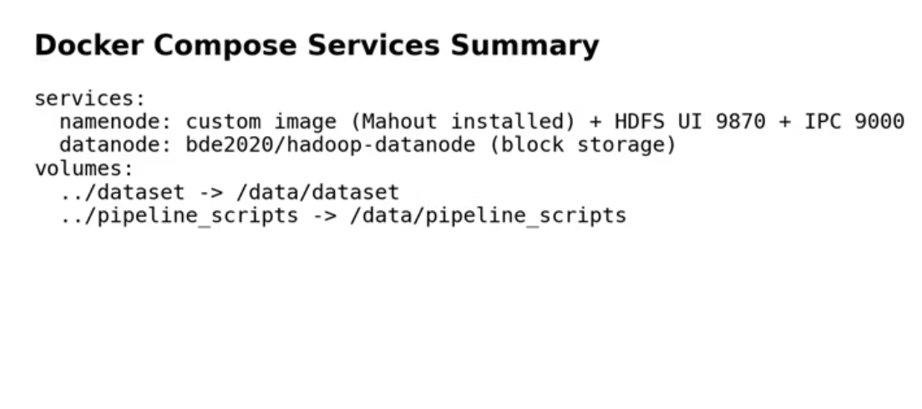
Distributed Storage Layer — Docker + HDFS
docker-compose.yml Services
NameNode: hadoop-mahout-namenode — Mahout 0.13.0 + Hadoop 3.2.1
DataNode: bde2020/hadoop-datanode — data block storage
Volume mounts: ../dataset → /data/dataset, ../pipeline_scripts → /data/pipeline_scripts
HDFS Web UI: localhost:9870 · IPC port: 9000
Raw data → /movie_data_raw; Filtered → /movie_data_filtered (17 genres)
Cluster name: movie-genre-cluster

Slide 9



AI Engine — Mahout MapReduce Pipeline
Our distributed AI engine leverages Apache Mahout and Hadoop MapReduce for efficient movie genre classification. The pipeline orchestrates several scripts and MapReduce jobs in a sequential flow.
Data Ingestion to HDFS
Mahout Preprocessing (TF-IDF)
CNB Model Training & Eval
0_prepare_filtered_hdfs.sh rebuilds the 17-genre dataset; 1_upload_to_hdfs.sh moves local data to HDFS /movie_data_raw.
3_train_and_test_lr.sh splits data (80/20), trains a Complementary Naive Bayes model, and evaluates it with a Confusion Matrix + AUC.
2_preprocess_mahout.sh executes seqdirectory for SequenceFiles and seq2sparse for TF-IDF vectorization.
Notes:
Complementary Naive Bayes (CNB) is an evolution of the standard Naive Bayes algorithm, specifically designed to fix some of standard Naive Bayes' biggest flaws when dealing with imbalanced datasets. Standard Naive Bayes calculates the probability that a movie belongs to a specific genre by looking at its features. Instead of calculating the probability that a movie belongs to a specific genre (e.g., "What are the odds this is a Drama?"), CNB calculates the probability that the movie belongs to all OTHER genre

Slide 10
TF-IDF Vectorisation — seq2sparse Deep Dive
Command: mahout seq2sparse [params]
-i Input
-o Output
-a Analyzer
-ml 5
SequenceFiles from /movie_data_filtered
Vectors to /movie_data_vectors
org.apache.lucene.analysis.en.EnglishAnalyzer for Porter stemming + stop-word removal; e.g. running/runs/ran → run
Keep terms with log-likelihood ≥ 5
-x 70
Ignore terms appearing in more than 70% of documents
-ng 2 N-grams
-wt tfidf Weighting
-nv Named vectors
Extracts unigrams and bigrams
-n 2
TF-IDF term weighting scheme
Preserves document labels in the output
Apply L2 normalisation to output vectors

Slide 11
Complementary Naive Bayes Classifier
Our AI engine utilizes the Complementary Naive Bayes (CNB) algorithm, specifically chosen for its robustness in handling imbalanced datasets inherent in movie genre classification.
Feature
Standard Multinomial Naive Bayes
Complementary Naive Bayes (CNB)
Training Approach
Trains on documents within each class.
Trains on documents in the complement of each class (all documents not in that class).
Class Imbalance
Heavily biased towards majority classes (e.g., Drama).
Less affected by class imbalance; robust with skewed distributions.
Bias Reduction
Prone to misclassifying minority classes.
Reduces classification bias toward majority classes by modeling the "absence" of a class.
Use Case
Effective for balanced datasets.
Ideal for highly imbalanced text classification problems, like our movie genre dataset (e.g., Drama 3,235 vs. War 117 — a 27× ratio).

Slide 12
We focused our training on 6 primary genres with sufficient data density: Drama, Comedy, Action, Horror, Animation, and Thriller. The model achieved strong performance on the holdout test set.
0.87
Expected AUC Score
High Area Under the Curve (AUC) on the 20% holdout test set indicates excellent model discrimination.
Mahout Commands:
Training: mahout trainnb -i /movie_data_train -o /movie_genre_model -li /labelindex -a 1 -ow -c
Evaluation: mahout testnb -i /movie_data_test -m /movie_genre_model -l /labelindex -ow -o /test_results -c
Output: Full per-class Confusion Matrix + overall AUC score printed to the terminal.

Slide 13
PIPELINE EXECUTION WORKFLOW — COMMANDS
01
02
Fetch Movie Data
Enrich Dataset (Optional)
.venv\Scripts\python.exe data_ingestion\fetch_tmdb_movies.py
.venv\Scripts\python.exe data_ingestion\enrich_dataset.py
03
04
Start Docker Cluster
Access NameNode Container
cd docker_environment && docker-compose up -d --build
docker ps
docker exec -it hadoop-mahout-namenode bash
05
06
Run Pipeline Scripts
Review Output
bash /data/pipeline_scripts/0_prepare_filtered_hdfs.sh
bash /data/pipeline_scripts/1_upload_to_hdfs.s
Output printed to terminal

Slide 14
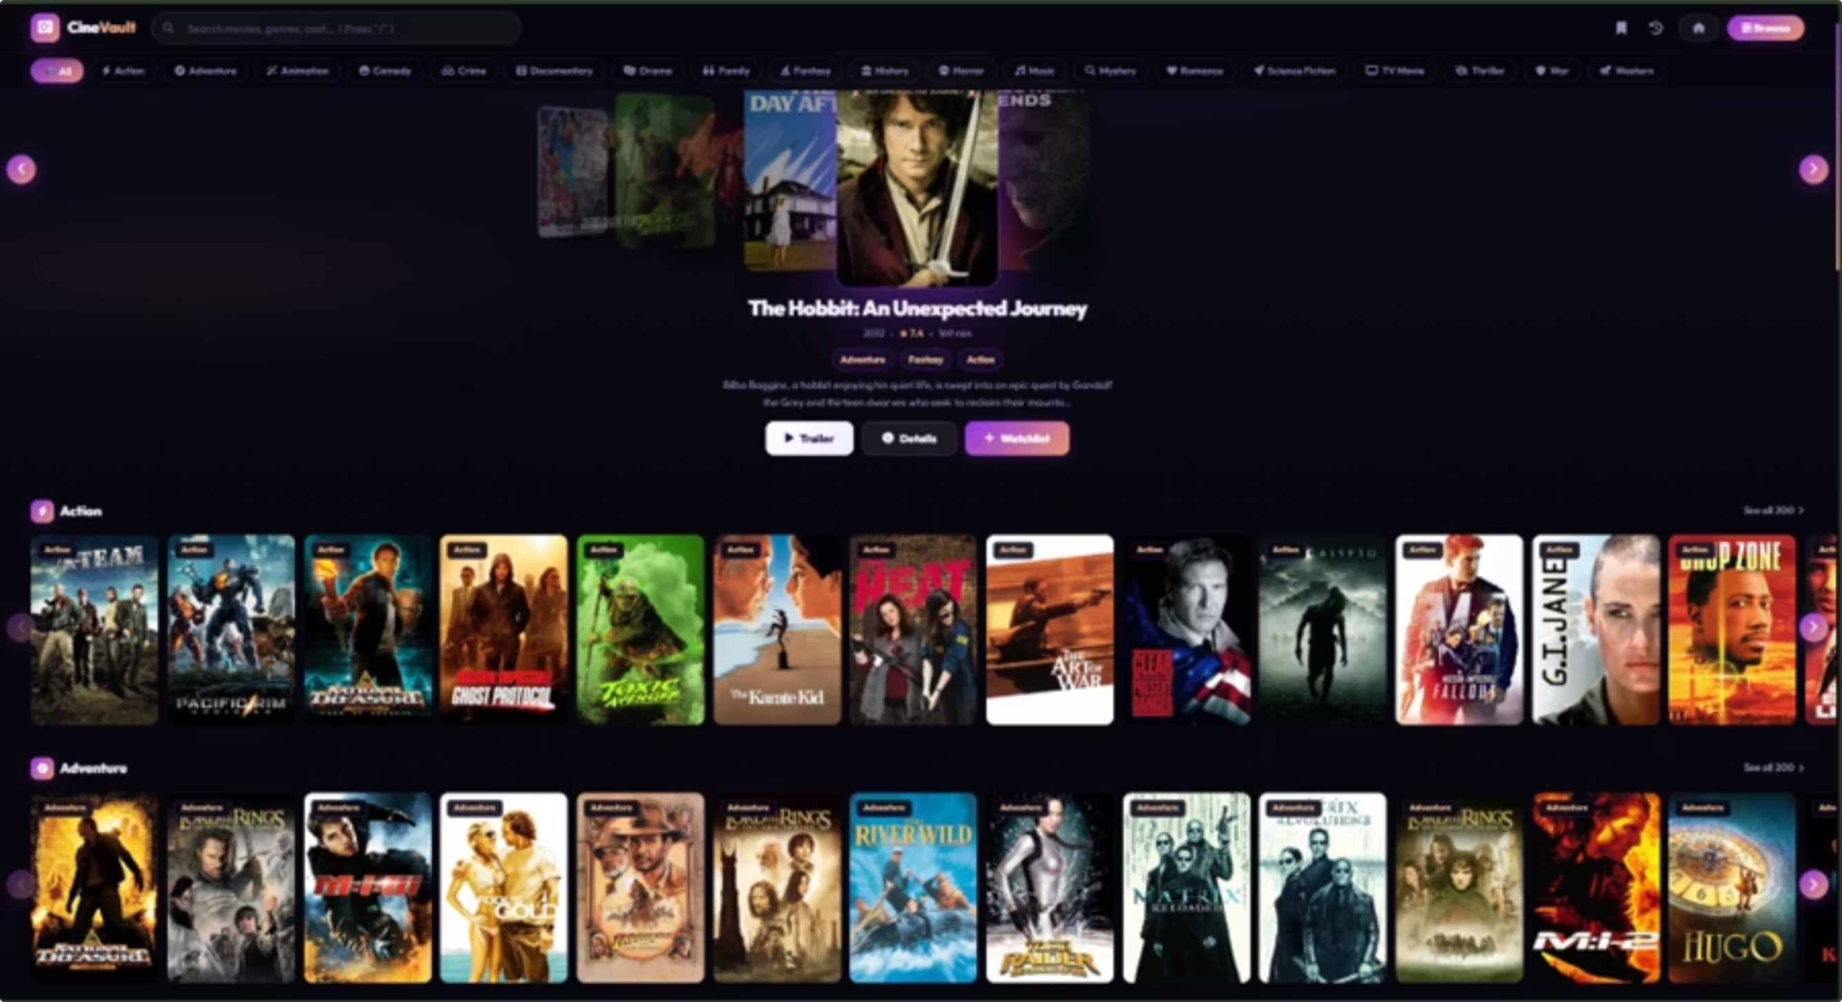
CINEVAULT DASHBOARD
Our interactive web application, movie_recommender/index.html, delivers a personalized movie discovery experience.

Slide 15
Recommender Scoring System
Our client-side recommendation engine dynamically personalizes movie suggestions using a robust scoring algorithm, ensuring each user's 'For You' row is uniquely tailored.
The scoring mechanism considers three key factors:
Feature
Description
genreMatch
Scores +2.0 if the primary genre matches user preference; +0.5 for a partial genre match.
ratingWeight
Derived from TMDB's vote_average, normalized to a [0, 1] range for consistent weighting.
recencyBoost
A higher boost is applied to newer release years, prioritizing fresh and current content.
Mahout-trained genre labels directly inform which genre directories are preferred for matching against user preferences.
User history, including viewed movies and implicit preferences, is stored and updated in localStorage with each movie interaction, constantly refining recommendations.
The result is a personalized, ranked list of movies rendered in the 'For You' swiper row, offering relevant and engaging content based on individual tastes.

Slide 16
KEY RESULTS & ACHIEVEMENTS
Our project successfully integrated a robust AI engine with a scalable infrastructure, culminating in a dynamic movie recommendation system.
13,711
0
0.87
Movies Collected
Manual Steps
Expected AUC
Enriched with keywords, cast, and taglines across 17 genres.
The entire pipeline executes automatically inside the container.
Achieved on a 20% holdout test set with Complementary Naive Bayes.
Key achievements include:
Storage: HDFS distributed block storage eliminates single-node memory limits.
NLP: TF-IDF vectorization with EnglishAnalyzer for Porter stemming, stop-word removal, and bigram extraction.
Deployment: Fully containerized with Docker, ensuring reproducible deployments in one command.
UI: CineVault SPA browses 3,000+ movies with real-time search and personalized recommendations.

Slide 17
CONCLUSION & FUTURE WORK
Conclusion
Successfully built a complete end-to-end Big Data NLP classification pipeline.
TMDB API ingestion → HDFS distributed storage → Mahout TF-IDF + CNB → CineVault UI.
Docker containerization ensures full portability and one-command reproducibility.
CNB algorithm effectively handles the 27× genre class imbalance in the dataset.
Project bridges Big Data infrastructure (Hadoop) with real-world web delivery (CineVault).
Future Work
Deep learning: Replace CNB with BERT/DistilBERT for richer text embeddings.
Real-time streaming: Apache Kafka for continuous TMDB data ingestion.
Multi-label classification: Movies can belong to multiple genres simultaneously.
Cloud deployment: AWS EMR or GCP Dataproc for production-scale HDFS clusters.
Model serving API: Flask/FastAPI backend to serve CNB predictions to CineVault live.

Slide 18

REFERENCES
[1] TMDB API Documentation
[2] Apache Mahout Documentation
[3] Hadoop HDFS Guide
[4] Docker Compose Reference
[5] Apache Lucene EnglishAnalyzer
[6] J. D. M. Rennie et al., 'Tackling the Poor Assumptions of Naive Bayes Text Classifiers,' ICML 2003
[7] G. Salton & C. Buckley, 'Term-Weighting Approaches in Automatic Text Retrieval,' IPM 1988
[8] bde2020/hadoop Docker images

